Slide 1

Introduction to
& Docker

Slide 2
Content
Introduction of Spring boot (Inverse control)
Customer registry Service (demo)
Docker deploy

Slide 3
Introduction of Spring boot (Inverse of control)
Dependency Injection

Slide 4
traditional object dependency v.s.
Dependency Injection
public class Bill {
private Title title;
private Date dueDate;
public Bill() {
title = new Title(title);
dueDate = new Date();
} }
public class Bill {
private Title title;
private Date dueDate;
public Bill(Title title,
Date dueDate) {
this.title = title;
this.dueDate = dueDate;
} }
The Object books’s implementation
without specifying the implementation of the Object that we want, inject the object directly
Any change in the code requires recompile, retest, redeployment, it increases the cost of the product.
Object instantiation is transferred outside the class

Slide 5
traditional object dependency v.s.
Dependency Injection
Bill bill = new Bill();
Title title = new Title(title);
Date dueDate = new Date();
Bill bill = new Bill(title, dueDate);
v.s.
Inverse of control(IoC)

Slide 6
Dependency Injection & Inverse Of Control
Here is a skeleton of Spring IoC, a concrete example will be followed to demonstrate the details of implementation.
Business Objects
(@Component)
Dependency
injection
Full configured
Application
Ready for use
IoC
Container
XML /
Java
annotations
configuration
creates
Beans
(@Bean)

Slide 7
2. Customer registry Service (demo)
2.1 quick review of the structure
2.2 Maven
2.3 Spring configuration

Slide 8
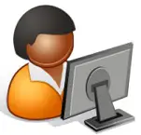





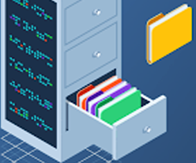
2.1 quick review of the structure
User raises request
to the browser
config
Browser sends request to controller
corresponding method
Controller calls Service Layer’s
Method to deal with the request
browser
controller
Service
Service layer uses Data Access Object
to operate on data.

Slide 9
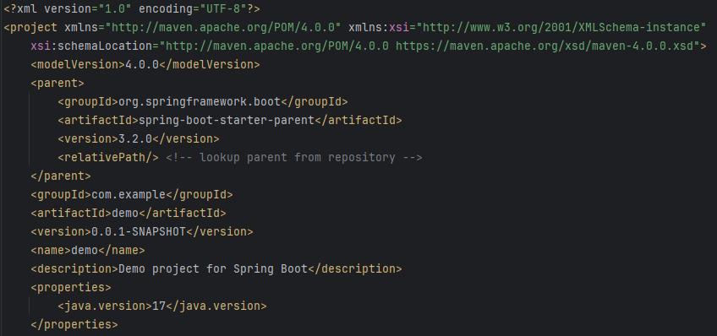
2.2 Maven
Dependency management (Maven) is about retrieving the right library dependencies (other project jar files, including their own dependencies) for your project as a whole.

Slide 10
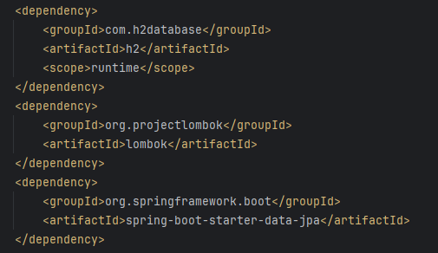
2.2 Maven
Dependency management (Maven) is about retrieving the right library dependencies (other project jar files, including their own dependencies) for your project as a whole.

Slide 11
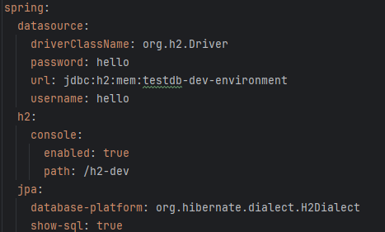
2.3 Spring configuration
Similar to web.xml
application.yml or application.properties

Slide 12
3. Docker deploy
3.1 Dockerfile
3.2 Run & Deploy

Slide 13
3.1 Dockerfile
FROM openjdk:17
WORKDIR /app
COPY ${ORIGINAL_JAR_FILE} ${DESTINATION}.jar
EXPOSE 8080
CMD ["java", "-jar", "${DESTINATION}.jar"]

